Slide 1
PESU I/O PROJECT
SALES PREDICTION
Team members-
Adithya
Dhanush
Akanksha

Slide 2
INTRODUCTION
Sales forecasting is the process of estimating future sales. Accurate sales forecasts enable companies to make informed business decisions and predict short-term and long-term performance.
We have made two Machine Learning models to predict sales. One model predicts sales using Artificial Neural Network and the other one is a time-series forecast.
Time series analysis comprises methods for analyzing time series data in order to extract meaningful statistics and other characteristics of the data. Time series forecasting is the use of a model to predict future values based on previously observed values.

Slide 3

TECHNIQUES USED
Data Pre-processing
Artificial Neural Networks
Time-Series Forecast
Visualisations

Slide 4
DATASET
The dataset used is a Superstore dataset.
It has different parameters like Shipment mode, Profit , Discount, Quantity,etc
Label encoding , One Hot Encoder is used to convert categorical data to numerical data.
Feature Scaling is done to give equal weightage to all the parameters
Also timedelta is calculated by using difference of Order date and Ship date, converted to float so that number of days for shipment can be used as a parameter.

Slide 5
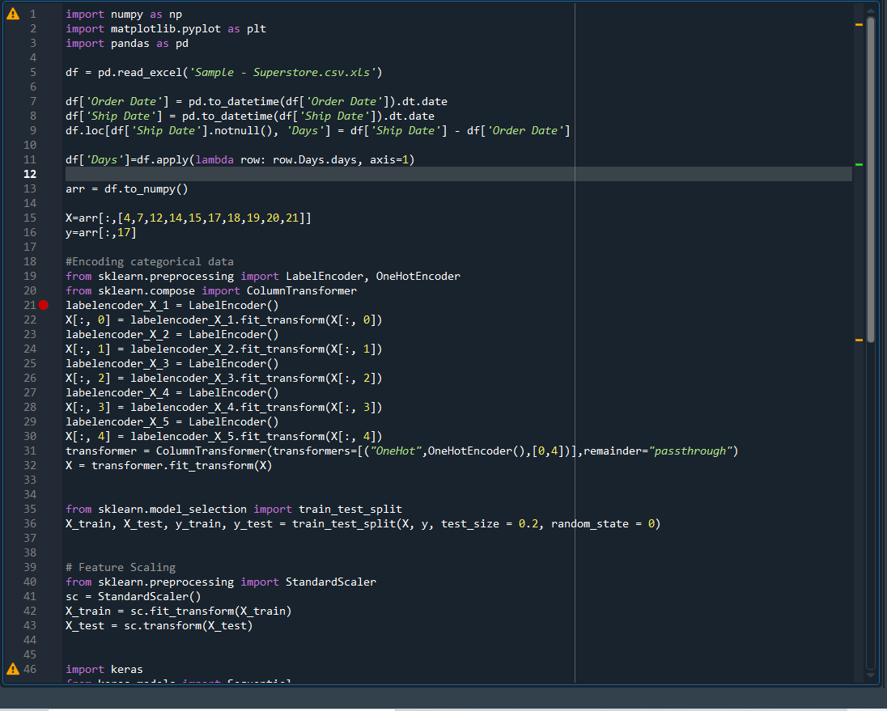
FORECASTING USING ANN - Data Preprocessing

Slide 6
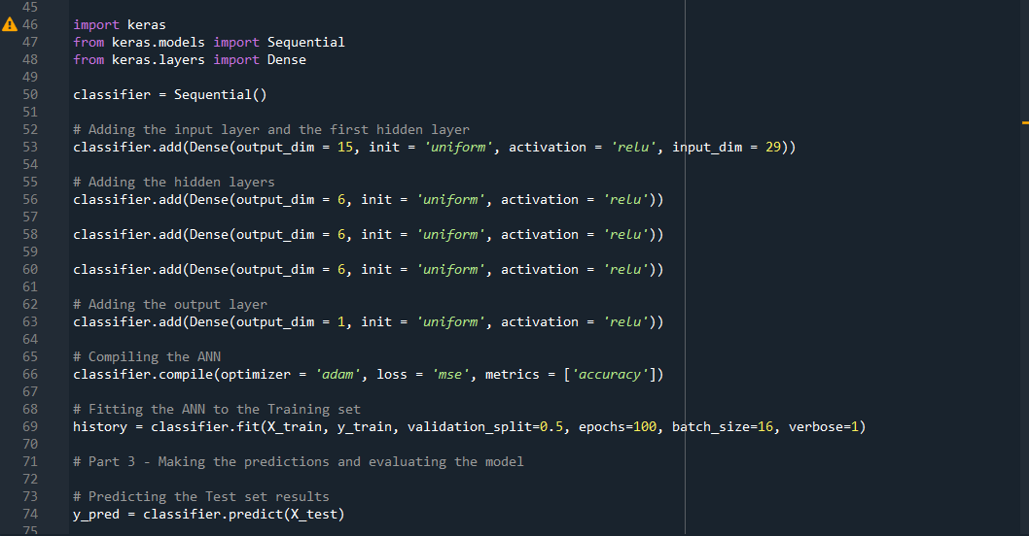
Artificial Neural Network

Slide 7
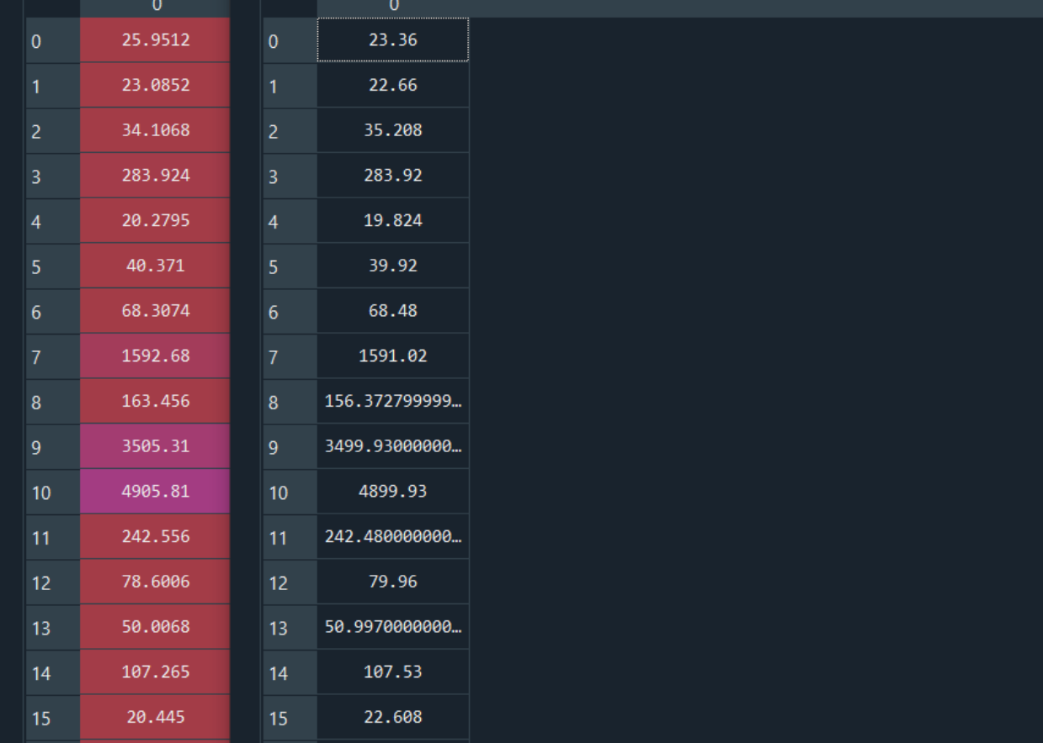
Actual VS Predicted values of Sales

Slide 8
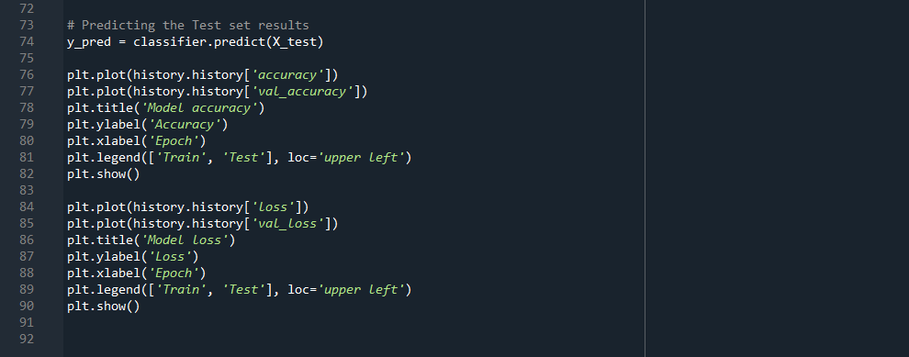
Visualisation

Slide 9
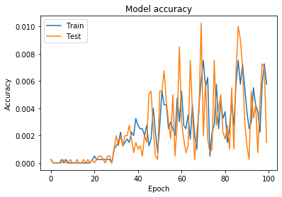
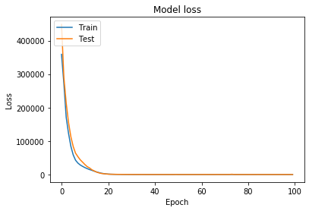

Slide 10
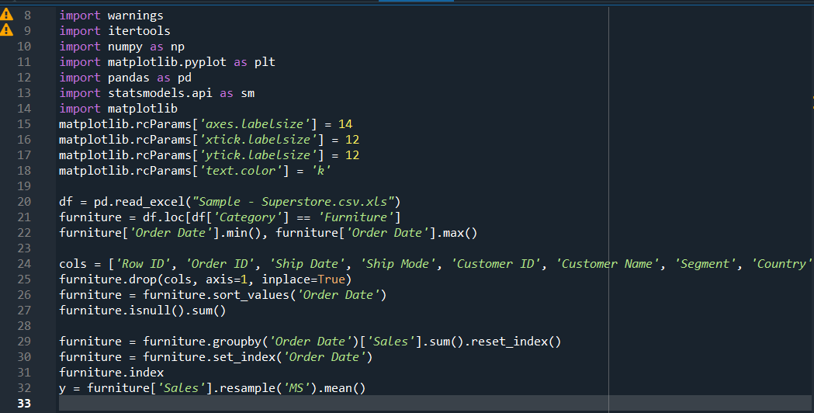
Time-Series Forecast - Data Pre-processing

Slide 11
Time series Forecast Using SARIMA
SARIMA stands for Seasonal Autoregressive Integrated Moving Average
Auto regressive(AR) model can be either simple,multiple or non-linear regression.
Differentiation step I eliminates non-stationarity
Moving average(MA) model uses weighting factors,where the recent observations are given higher weight.To identify the recent trend in the sales
Seasonal ARIMA can support a time series without a repeating cycle

Slide 12
SARIMA
SARIMA is used for a non-stationary series of dataset.It can identify the trend and seasonality of the data unlike ANN,is a forecasting algorithm based on the idea that the information in the past values of the time series can alone be used to predict the future values.
The python implementation is called SARIMAX instead of SARIMA because the “X” addition to the method name means that the implementation also supports exogenous variables.(a variable that is not affected by other variables in the system.)
An ARIMA model combines the AR and the MA terms.

Slide 13
TIME SERIES
A time series is a sequence where a metric is recorded over regular time intervals.
Forecasting is the next step where you want to predict the future values the series is going to take.
ARIMA models are denoted with the notation ARIMA(p, d, q). These three parameters account for seasonality, trend, and noise in data.
We can use a “grid search” to find the optimal set of parameters that yields the best performance for our model.In our dataset the lowest AIC value of 297.78 is obtained at order=(1, 1, 1) and seasonal_order=(1, 1, 0, 12)

Slide 14
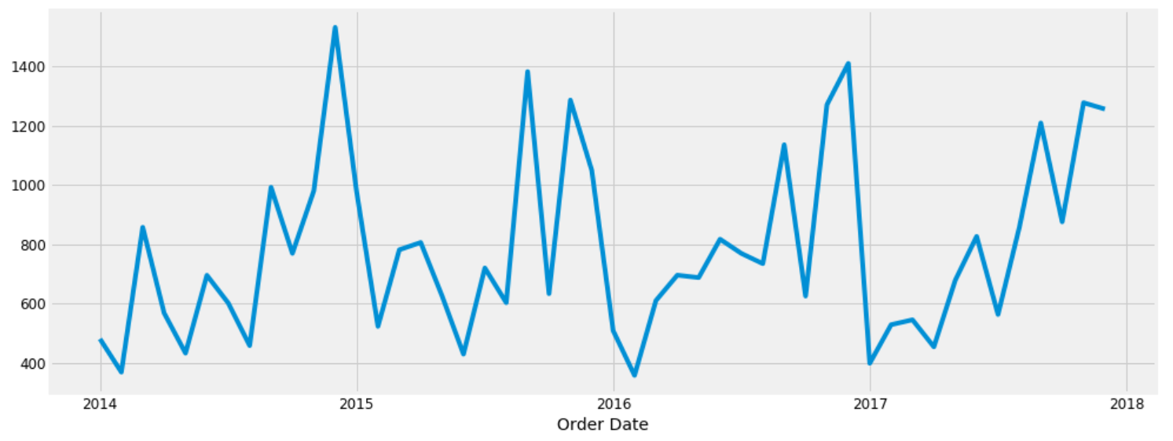

Slide 15
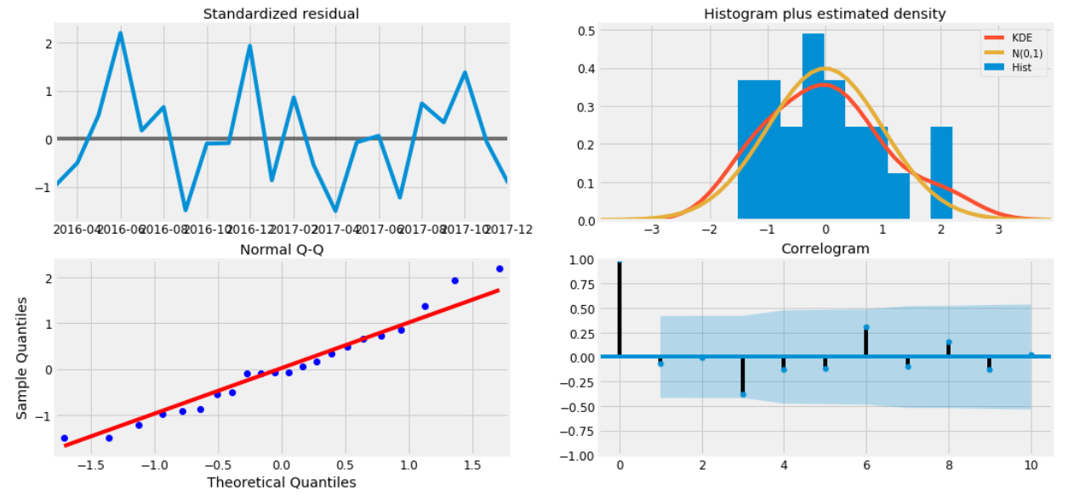
Model Diagnostics

Slide 16
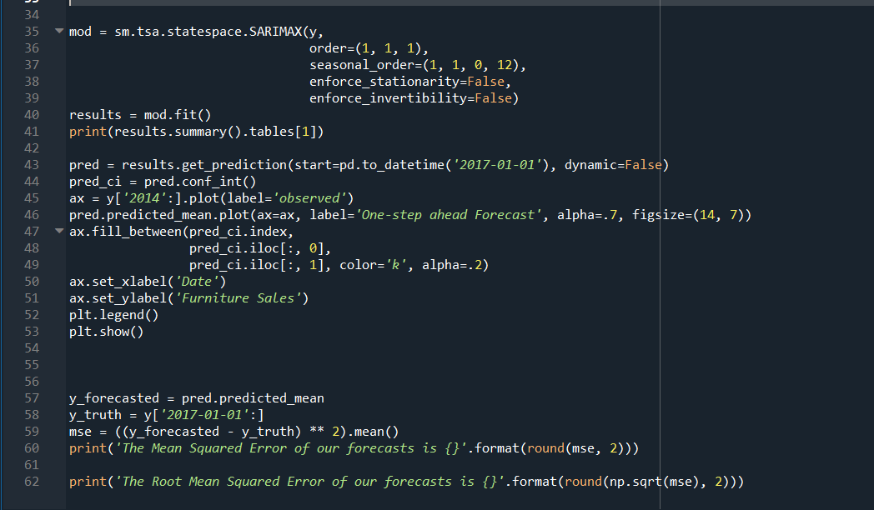
Time-Series forecast

Slide 17
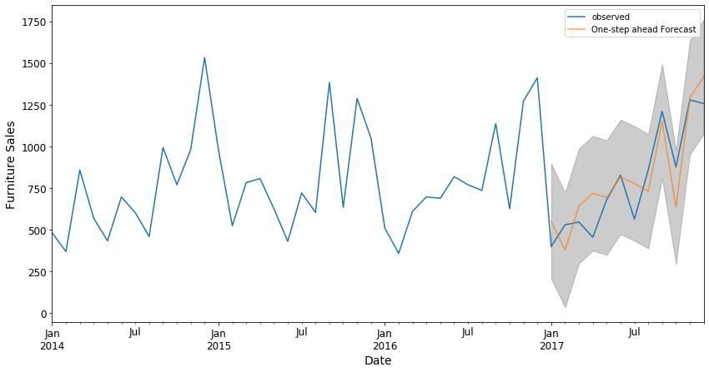
Visualisation

Slide 18
THANK YOU

